Slide 1
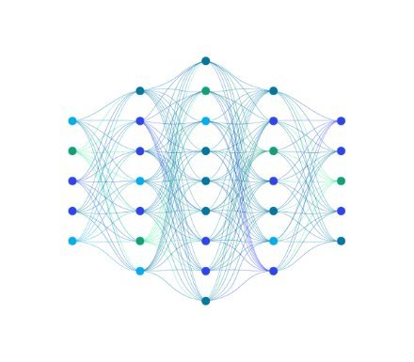
Problem Statement: Predicting Building Energy Consumption
You are tasked with developing a machine learning model that predicts building energy consumption based on factors like weather, building characteristics, and more. With buildings being major contributors to global energy use and carbon emissions, accurate predictions could enable organizations to implement targeted strategies to reduce energy waste, such as retrofitting high-use buildings to be more energy efficient.
Participants must make their own decisions on how they want to split and process the data, train their models, and present their findings.

